Slide 1
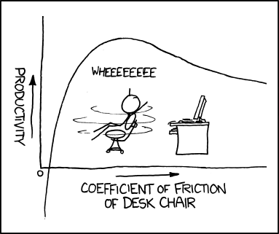
Chi-square tests
Geog4300/6300
Jerry Shannon

Slide 2
Variablesc | Tests; test statistics; SE
Continuous; one sample: σ known and n > 30 OR data is a proportion | One-sample z-test; Z; SE = σ/sqrt(n); OR Diff. of proportions
Continuous; one sample: σ unknown or n < 30 | One-sample t-test; t; SE = s/sqrt(n-1)
Continuous; two samples | Student’s t-test for difference of means
Continuous; paired samples | Paired t-test
Continuous; more than two samples | ANOVA
Discrete; two variables; counts | Chi-square, goodness of fit
Continuous; two or more variables | Regression
You are here

Slide 3
Two sample test and variable types
Statistical tests have independent and dependent variables.
Example: Do Georgia counties get more rain in July than Alabama counties do?
Categorical, discrete
Independent variable: State of residence
Dependent variable: Monthly rainfall
Ratio, continuous
What types of variables are these?

Slide 4
This is not always the case!
Dependent Variable | Independent Variable(s) | Test | Example hypotheses
Quantitative / ratio | Categorical/ nominal (2 values) | (n > 30): t-test for independent samples; | “The average speed of cars has changed between the times that speed cameras were operating and the times that they were not.”
 |  | (n < 30): Wilcoxon rank sum (non-parametric)
 | Categorical/ nominal (more than 2 values) | ANOVA | “The amount the average household gives to charity each year depends on whether the resident lives in the East, the Midwest, the South, or the West.”
Categorical | Categorical | Chi-squared test | “The typical denomination of churches depends on the state (Utah has more LDS churches, New York has more Roman Catholic churches)”
Quantitative | Quantitative (1 variable) | Correlation/ regression | “The median household income of a census tract is a good indicator of the voter turnout percentage at primary elections.”
Quantitative | Quantitative (more than one variable) | Multiple regression | “Student test scores are a function of the median income, amount spent per capita on education, and average number of years of schooling of teachers in a census tract.”

Slide 5
Chi-square tests are used with ordinal/nominal (categorical) data.
They test whether the observed data matches expected values.

Slide 6
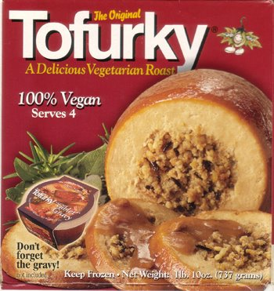
An example
Survey of football fans:
Does your football team tell you something
about your Thanksgiving meal preference
(dark/white meat or tofurkey)?
What are the independent and dependent variable?
Independent: Football team (Nominal)
Dependent: Meal choice (Nominal)

Slide 7
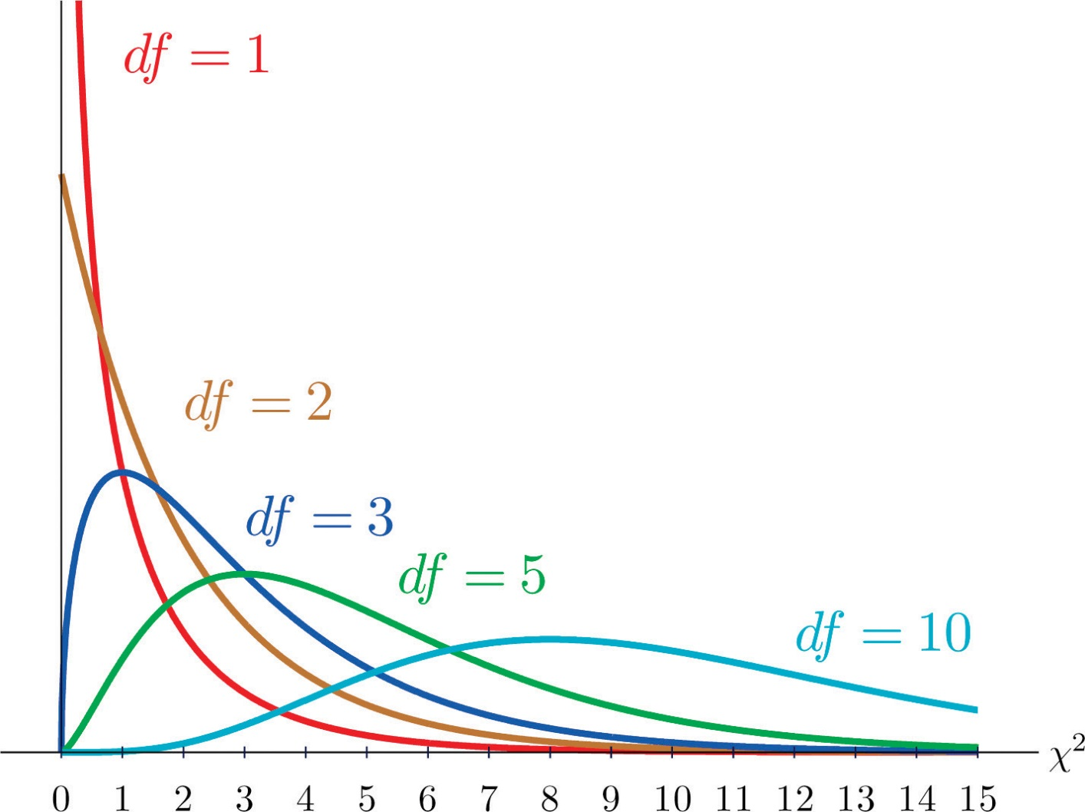
How chi-square works
The test statistic is a χ²
It has its own distribution, just like t or z.

Slide 8
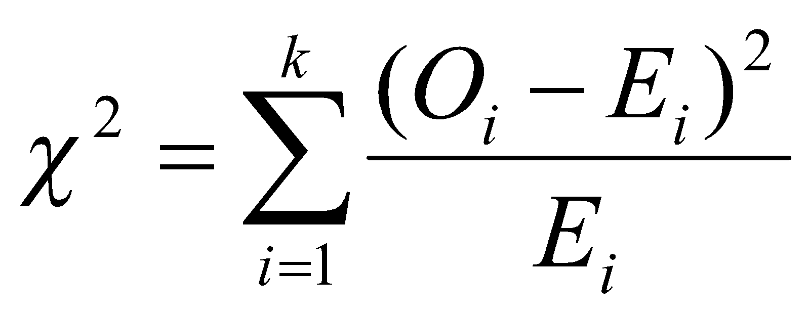
The test for chi-square follows this formula:
O_{i} = Observed value for observation i
E_{i} = Expected value for observation i
k = Number of observations in all groups

Slide 9
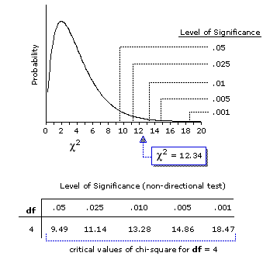
A statistic above the critical value shows a difference between observed and expected values
Vassarstats.net

Slide 10
ESPN surveyed 85 football fans…
 | White meat | Dark meat | Tofu-rkey | TOTAL
Lions | 15 | 25 | 3 | 43
Cowboys | 25 | 10 | 7 | 42
TOTAL | 40 | 35 | 10 | 85
This contingency table shows turkey preference as a function of (“contingent upon”) team preference.

Slide 11
What are the null and alternate hypotheses?
H₀: There is no difference in meat preference between Lions and Cowboys fans
H_{A}: There is a difference in meat preference between Lions and Cowboys fans

Slide 12
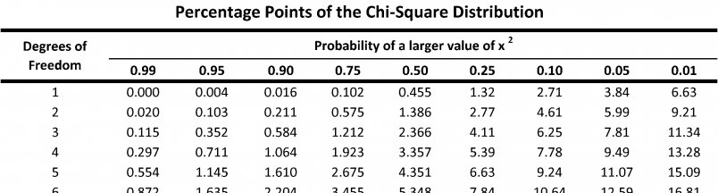
What’s our critical value?
Degrees of freedom = (#rows -1)*(#cols-1) = (2-1)(3-1) = 2
Look up critical χ² value on a χ² table (p. 312)
Here, for 95% confidence, χ² = 5.99

Slide 13
To find the expected value of each group, divide up the totals as if groups made no difference.
Start by figuring out what percentage of all fans liked each type of meat.
 | White meat | Dark meat | Tofu-rkey | TOTAL
Lions |  |  |  | 43
Cowboys |  |  |  | 42
TOTAL | 40 (47%) | 35 (41%) | 10 (12%) | 85

Slide 14
Multiply those percentages by the row totals to find the expected values.
(Fractional values are OK)
 | White meat | Dark meat | Tofu-rkey | TOTAL
Lions | =.47 * 43 = 20.2 | =.41 * 43 = 17.7 | =.12 * 43 = 5.1 | 43
Cowboys | =.47 * 42 = 19.8 | =.41 * 42 = 17.3 | =.12 * 42 = 4.9 | 42
TOTAL | 40 (47%) | 35 (41%) | 10 (12%) | 85

Slide 15
Compare expected and observed values
 | White meat | Dark meat | Tofu-rkey | TOTAL
Lions | O = 15 E = 20.2 | O = 25 E = 17.7 | O = 3 E = 5.1 | 43
Cowboys | O = 25 E = 19.8 | O = 10 E = 17.3 | O = 7 E = 4.9 | 42
TOTAL | 40 (47%) | 35 (41%) | 10 (12%) | 85

Slide 16
χ² = (15-20.2)² / 20.2 + … (7-4.9)² / 4.9
= 10.82
 | White meat | Dark meat | Tofu-rkey | TOTAL
Lions | O = 15 E = 20.2 | O = 25 E = 17.7 | O = 3 E = 5.1 | 43
Cowboys | O = 25 E = 19.8 | O = 10 E = 17.3 | O = 7 E = 4.9 | 42
TOTAL | 40 (47%) | 35 (41%) | 10 (12%) | 85

Slide 17

Our chi square statistic was 10.82
The critical value was 5.99
We can reject our null hypothesis.
Thanksgiving meat preference is affected by team preference.

Slide 18
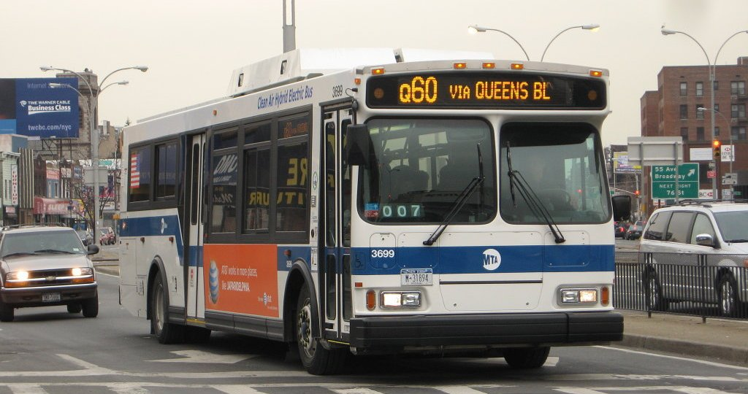
You try it!

